Slide 1

Tomato plant leaf and Disease recognition Course Name: Data Mining Lab Course Code: CSE476 Intake – 41

Slide 2
Presented By –Group No – 07
Hasan Al Mahmud [18192103239]
Hashibur Rahman [18192103276]
Rifatul Islam [18192103187]
Tahamina Akther Ruma [18192103225]
Shakil Ahamed Raju [15162103136]
Jannatul Kobra [17182103296]
Presented To –
Khan Md. Hasib
Assistant Professor
Department of CSE
Bangladesh University of Business and Technology (BUBT)
Email: khanmdhasib@bubt.edu.bd

Slide 3
Table of Contents
Introduction
Literature Review
Methodology
Results and Discussion
Conclusion
Future work

Slide 4
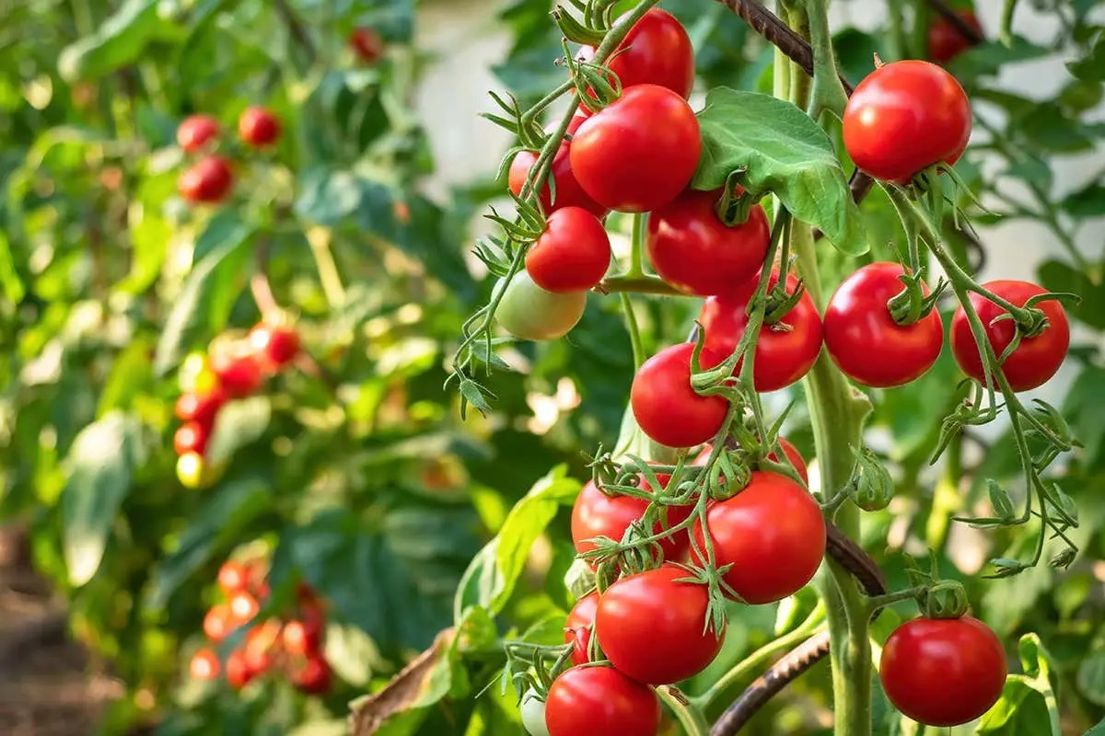
Introduction
Importance of Tomato Plants:
Tomatoes are one of the most widely consumed vegetables globally, and tomato plants play a vital role in food security.
However, the yield and quality of tomato plants can be significantly affected by various diseases, such as bacterial spot, early blight, and late blight.

Slide 5
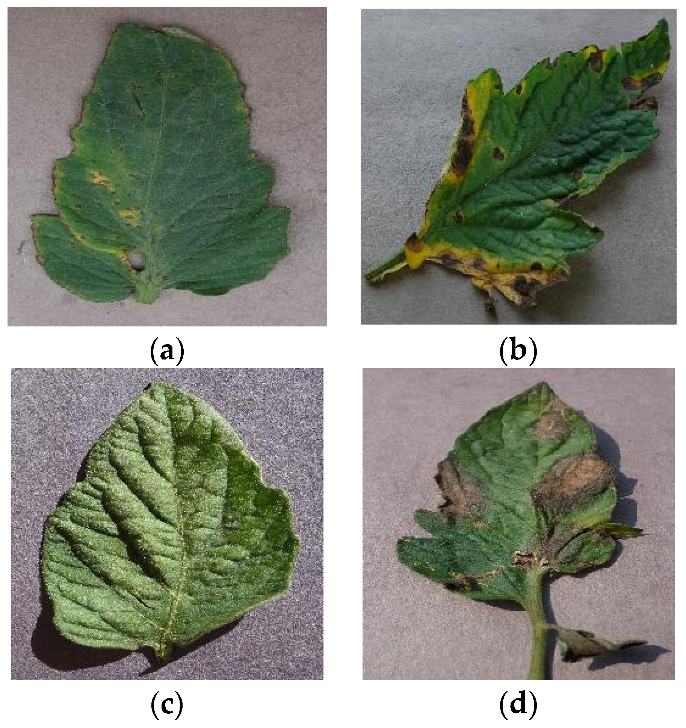
Plant Diseases and their impact on Tomato Plants:
Plant diseases cause significant economic losses to farmers, as well as a decrease in the overall food supply. The visual symptoms of plant diseases can be detected by observing the leaves, stems, and fruits of the plant. Early detection and treatment of plant diseases are essential to prevent the spread of the disease and reduce crop losses.

Slide 6
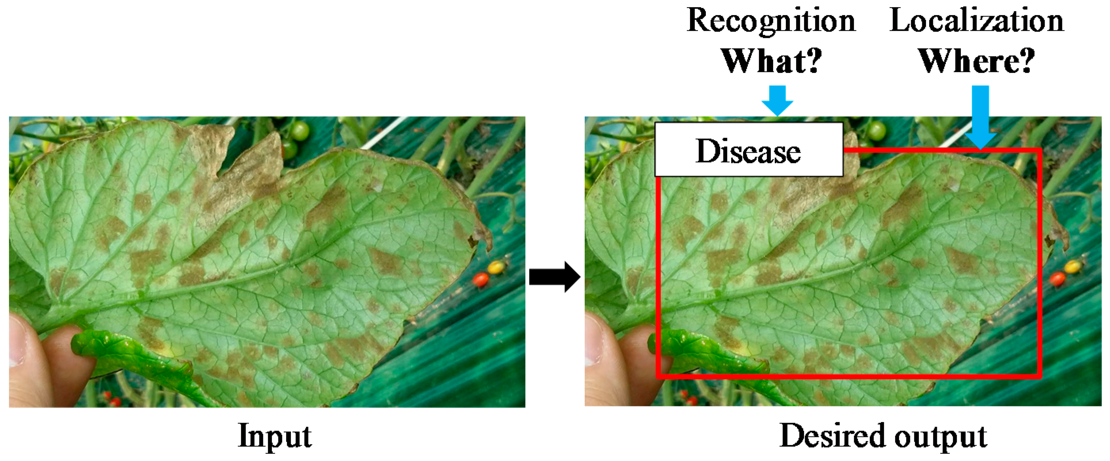
The need for a fast and accurate recognition system:
The traditional method of plant disease detection is by visual inspection, which can be time-consuming and error-prone. Therefore, there is a need for a fast and accurate recognition system that can identify plant diseases accurately and quickly.

Slide 7
CHALLENGES
Variety of diseases
Complex leaf structure
Limited data
Limited computing power
Variability in disease symptoms

Slide 8
Literature Review
Existing methods for Tomato Plant Disease Recognition:
Various methods have been proposed for plant disease recognition, including traditional image recognition methods such as Support Vector Machines (SVM) and Decision Trees (DT). However, these methods have limitations in terms of accuracy and speed.

Slide 9
The limitations of traditional image recognition methods:
Traditional image recognition methods are limited in their ability to handle complex and diverse data. These methods require feature extraction and selection, which can be time-consuming and may lead to loss of important information.

Slide 10
The effectiveness of Convolutional Neural Networks (CNNs):
Convolutional Neural Networks (CNNs) have shown promising results in image recognition tasks, including plant disease recognition. CNNs can learn features automatically from raw images, which makes them more effective in handling diverse and complex data.

Slide 11
Methodology
Data collection and preprocessing:
A dataset of tomato plant leaf images with different diseases was collected from various sources such as Kaggle.com
The dataset was preprocessed to remove noise and augment the data by applying various transformations such as zooming, rotation, flipping, and scaling.

Slide 12
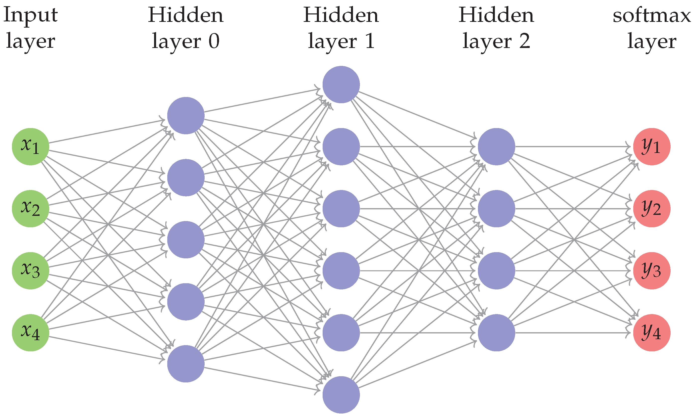
CNN Architecture and Training:
A CNN model was developed using a deep neural network architecture. The model is a supervised learning approach.
The model was optimized using the Adam optimization algorithm, and the training was performed on a GPU for faster processing. And the last layer’s activation function is softmax.

Slide 13
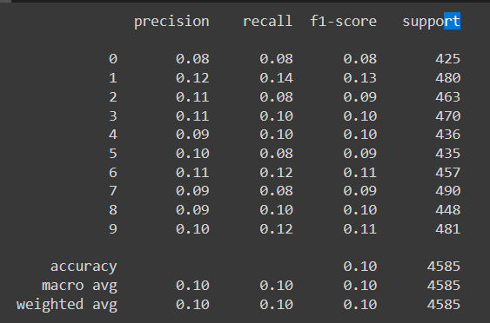
Model Evaluation Metrics:
The performance of the CNN model was evaluated using various metrics such as accuracy, precision, recall, and F1 score. The confusion matrix was also used to analyze the model's performance.

Slide 14
Results and Discussion
Performance evaluation of the CNN model:
The CNN model achieved high accuracy in identifying tomato plant diseases. The model outperformed traditional image recognition methods such as SVM and DT in terms of accuracy and speed.

Slide 15
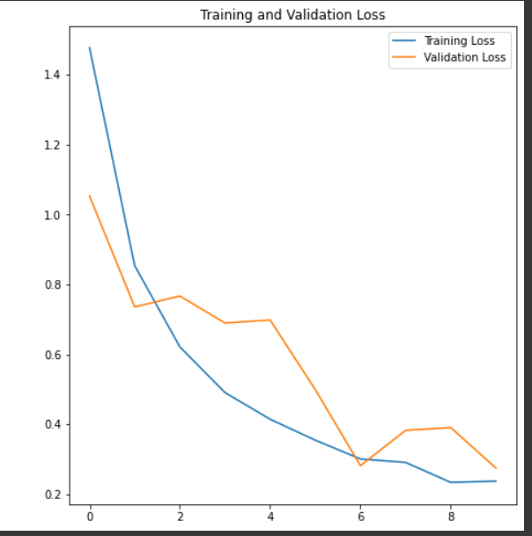
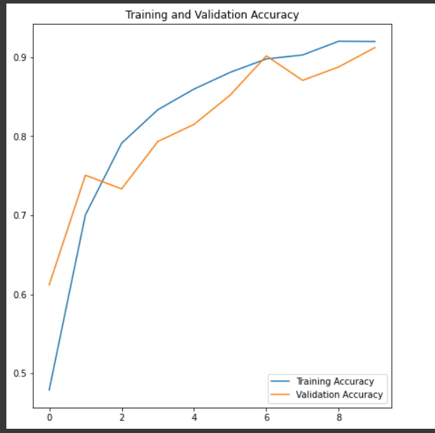
Training and validation loss vs Training and validation accuracy

Slide 16
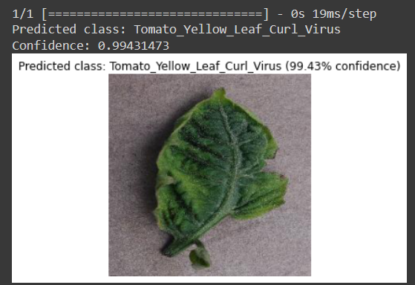
Analysis of the accuracy and reliability of the proposed system:
The proposed system showed high accuracy in detecting various tomato plant diseases. However, the system's reliability can be affected by factors such as lighting conditions and leaf orientation during image capture.

Slide 17
Conclusion And Future Work
Conclusion:
In conclusion, the proposed CNN-based system for tomato plant leaf and disease recognition has shown promising results in terms of accuracy and speed. The system can contribute to early detection and treatment of plant diseases, leading to increased crop yield and food security.

Slide 18
Limitations and future work:
The proposed system has limitations in terms of its reliability under varying lighting conditions and leaf orientations. Further research can focus on addressing these challenges and expanding the system to include more plant species and diseases.
Potential applications of the proposed system:
The proposed system can be applied to various agricultural settings to detect plant diseases early and prevent crop losses. The system can also be used in research and education to study the impact of plant diseases on food security and plant health.

Slide 19
Thank You All

